Slide 1
LOGIC AND REASONING

Slide 2
Departmental Vision –
Empowering the students to be professionally competent & socially responsible for techno-economic development of society.
Departmental Mission –
To provide quality education enabling students for higher studies, research and entrepreneurship.
b) To inculcate professionalism and ethical values through day to day practices.

Slide 3
Syllabus:
Knowledge Based Reasoning : Agents
Logic and Inferences:
Formal Logic
Propositional Logic and First Order Logic.
Resolution in Propositional Logic and First Order Logic.
Deductive Retrieval
Backward Chaining
Second Order Logic
Knowledge Representation : Conceptual Dependencies, Frames, Semantic Nets

Slide 4
KNOWLEDGE BASED AGENTS
A knowledge based agent needs the knowledge of how to act.
A knowledge-based agent includes a knowledge base and an inference system.
A knowledge base(KB) is a set of representations of facts or information of the world.
Each individual representation is called a sentence.
The sentences are expressed in a knowledge representation language.
The agent operates as follows:
1. It TELLs the knowledge base what it perceives.
2. It ASKs the knowledge base what action it should perform.
3. It performs the chosen action.

Slide 5
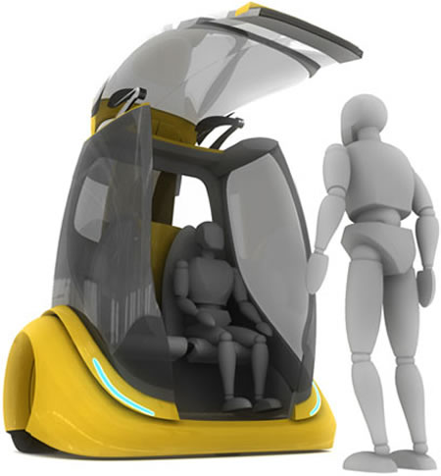
Architecture Of a KB Agent
Knowledge Level
The most abstract level: describe agent by saying what it knows
Ex: A taxi agent might know that the Golden Gate Bridge connects San Francisco with the Marin County
Logical Level
The level at which the knowledge is encoded into sentences .
Ex: links(GoldenGateBridge, SanFrancisco, MarinCounty)
Implementation Level
The physical representation of the sentences in the logical level
Ex: ‘(links goldengatebridge sanfrancisco marincounty)

Slide 6
Logic
Logics helps to understand the process of reasoning.
Logic is required for representing knowledge.
Logics are formal languages for representing information such that conclusions can be drawn.
Logic involves syntax, semantics and inference procedure.
Syntax defines the sentences in the language.
Semantics define the "meaning" of sentences.
i.e., define truth of a sentence in a world
E.g., the language of arithmetic
x+2 ≥ y is a sentence; x2+y > { } is not a sentence.
x+2 ≥ y is true in a world where x = 7, y = 1
x+2 ≥ y is false in a world where x = 0, y = 6.

Slide 7
Entailment
It defines logical involvement between two sentences or facts.
Assume x and y are two sentences whose relationship is to be determined. It can be given as-
x y
It indicates that if sentence x entails y which means that -
when x is true then y is also true.

Slide 8
Entailment
Another example,
KB = {p=5}
Then, KB I= {p +2 = 7}

Slide 9
Logic
Logic is basically a formal notation to represent knowledge that allows to make inference and helps to solve a problem.
Main types of logic are:-
Propositional / Sentential Logic –
Study of statements and their connectivity.
Predicate Logic/ First Order Logic(FOL) –
Study of individuals and their properties.

Slide 10
Propositional Logic
A proposition is a statement, which in English would be a declarative statement.
Eg:- The sky is blue , the snow is white, 2+2 =4.
Every proposition is either true or false.
Propositions are the sentences that are either true or false but not both.
Propositional logic is fundamental to all other types of logic.
Propositional logic is also called as Propositional Calculus, Sentential calculus or Boolean Algebra.

Slide 11
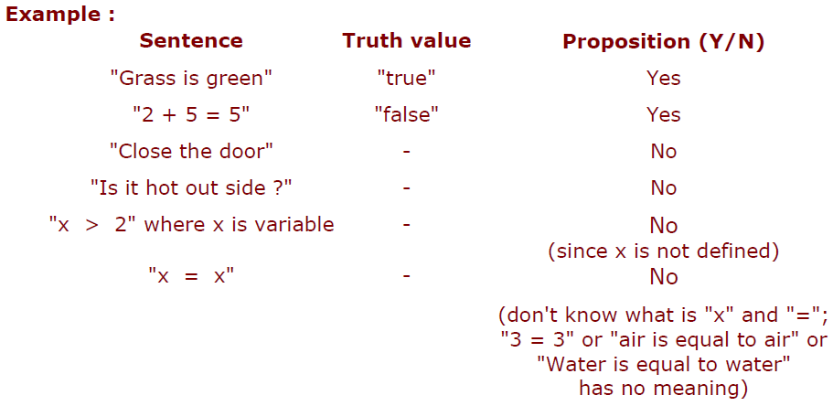
Propositional Logic
A sentence is a smallest unit in propositional logic.
If proposition is true, then truth value is true.
If proposition is false, then truth value is false.

Slide 12
Propositional Logic(PL)
Syntax –
The syntax of PL defines allowable sentence.
The atomic sentence consist of a single proposition symbol.
Each such symbol stands for propositions that can be true or false.
Statement can be simple or compound.
Simple statements are either TRUE or FALSE.
Compound or complex statements are constructed from simple statements connected by connectives.
Literal: atomic sentence or negated atomic sentence
Eg:- P, ¬ P

Slide 13
Basic symbols
Expressions only evaluate to either “true” or “false.”
P “P is true”
¬P “P is false” negation
P V Q “either P is true or Q is true or both” disjunction
P ^ Q “both P and Q are true” conjunction
P => Q “if P is true, then Q is true” implication
P ⬄ Q “P and Q are either both true or both false” equivalence

Slide 14
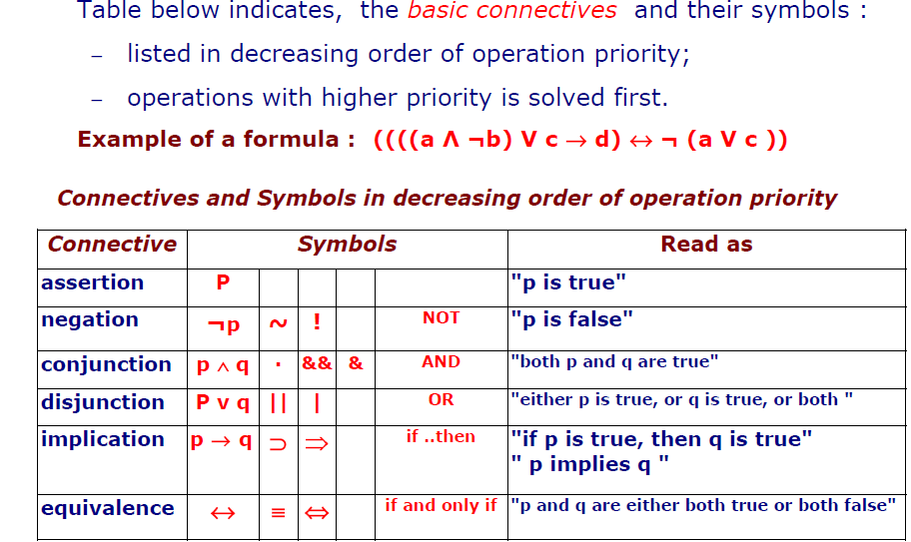
Connectives Or Operator
Connectives join simple statements into compound statement.

Slide 15
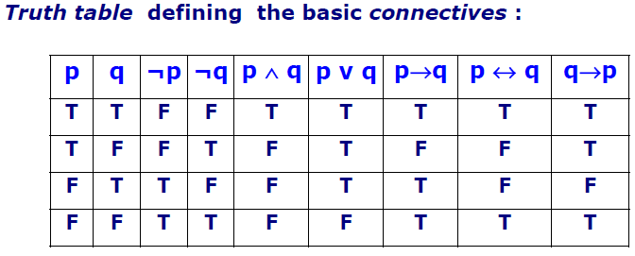
Semantic
Semantic tells about the rules to determine the truth of a sentence.

Slide 16
Examples of PL sentences
Let Q represent “It is humid.”
Let P represent “ It is hot”
Let R represent “ It is raining”
(P ∧ Q) → R
“If it is hot and humid, then it is raining”
Q → P
“If it is humid, then it is hot”

Slide 17
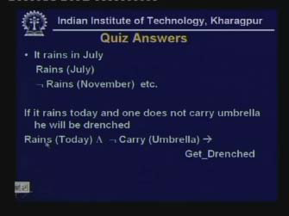
Example

Slide 18
Propositional logic: basic manipulation rules
¬(¬A) = A Double negation
¬(A ^ B) = (¬A) V (¬B) Negated “and”
¬(A V B) = (¬A) ^ (¬B) Negated “or”
A ^ (B V C) = (A ^ B) V (A ^ C) Distributivity of ^ on V
A => B = (¬A) V B by definition
¬(A => B) = A ^ (¬B) using negated or
A ⬄ B = (A => B) ^ (B => A) by definition
¬(A ⬄ B) = (A ^ (¬B))V(B ^ (¬A)) using negated and & or
…

Slide 19
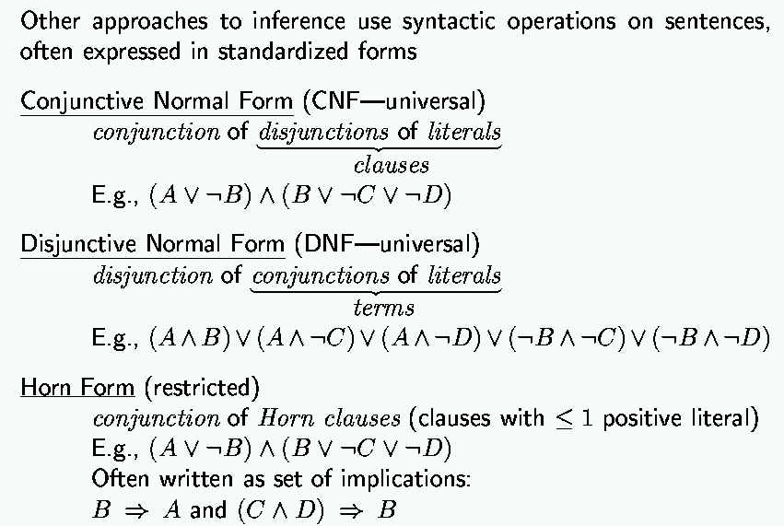
Propositional inference: normal forms
“product of sums of
simple variables or
negated simple variables”
“sum of products of
simple variables or
negated simple variables”

Slide 20
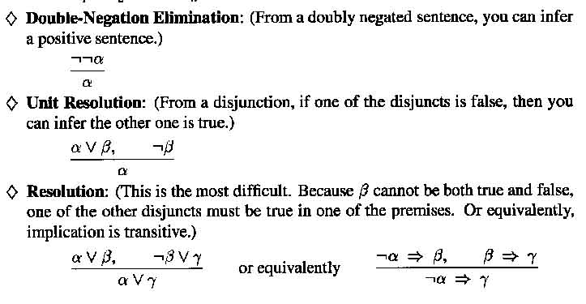
Inference Rules

Slide 21
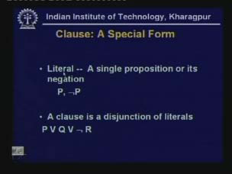
Inference in PL

Slide 22
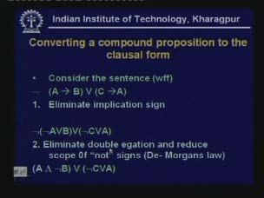

Slide 23
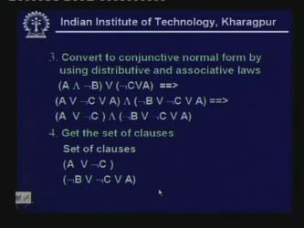

Slide 24
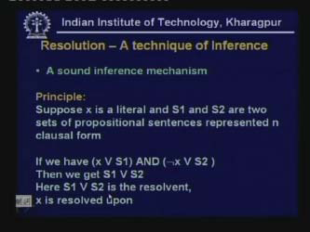
Resolution : An Inference technique in PL

Slide 25
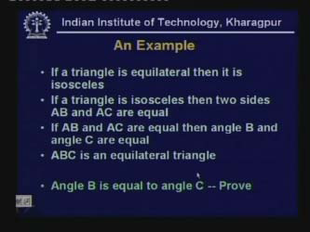
Resolution in PL

Slide 26
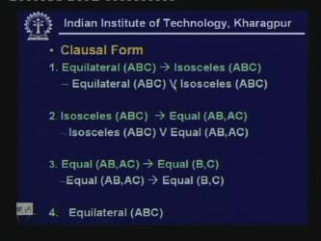
Solution

Slide 27
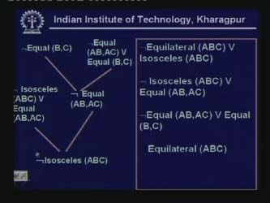

Slide 28
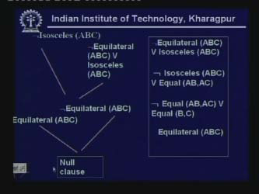

Slide 29
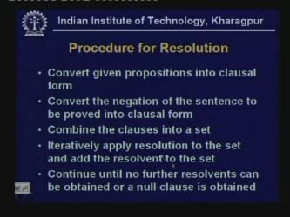

Slide 30
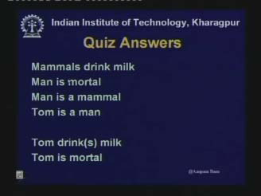
Example 2 –

Slide 31
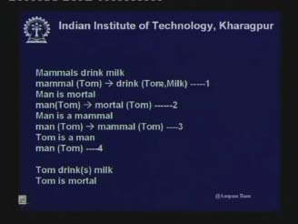

Slide 32
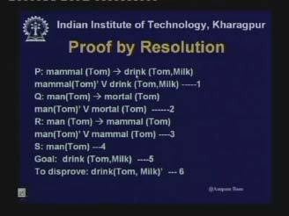

Slide 33
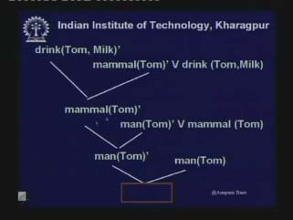

Slide 34
Advantages Of Propositional Logic:-
Simple knowledge representation language.
Allows inference to be made.
Disadvantages Of Propositional Logic:-
Cannot express complex AI problems.
It cannot identify entity as individual .
It cannot represent properties of individual entities or relations between them. Eg:- Jay is tall.
Cannot represent generalization, specialization, etc.

Slide 35
Predicate/ First Order Logic(FOL)
FOL is more expressive than PL.
Predicate logic allows to describe the objects and their relationships.
Eg:- All kids are naughty, Suzy is a kid.
FOL can represent information using relations, variables, quantifiers.
Example:-
Every elephant is gray: ∀ x (elephant(x) → gray(x))
There is a white alligator: ∃ x (alligator(X) ^ white(X))

Slide 36
Predicate
A sentence is in predicate logic is made up of constants, predicates and functions.
Every complete sentence is made up of 2 parts:
The subject – what(or whom) the sentence is about.
Predicate – tells something about object.
Eg:- Judy{runs} so subject is Judy and Predicate is runs.
The car is blue so {is blue} is a predicate that represents some property.
It will be represented as B(x) where B is blue and x is an object. i.e B(car) is read as car is blue.

Slide 37
First Order Logic
Constants are objects: john, apples
Predicates are properties and relations:
likes(john, apples)
Functions transform objects:
likes(john, fruit_of(apple_tree))
Variables represent any object: likes(X, apples)
Quantifiers qualify values of variables
True for all objects (Universal): ∀X. likes(X, apples)
Exists at least one object (Existential): ∃X. likes(X, apples)

Slide 38
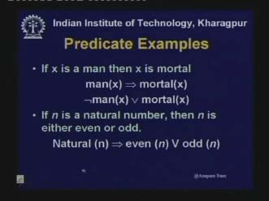
Predicate Logic

Slide 39
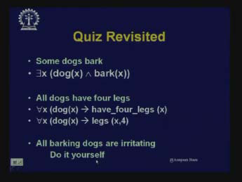
Examples

Slide 40
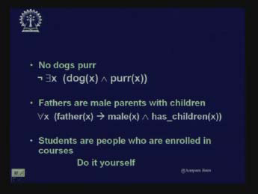
Examples

Slide 41
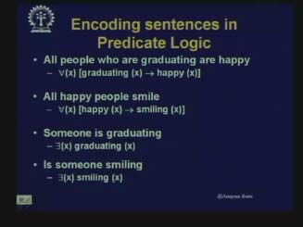

Slide 42
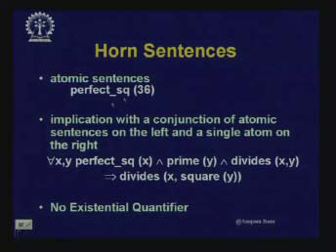

Slide 43
Unification and Lifting : Inference in FOL
In FOL quantifiers are present. But in order to find the inference, quantifiers has to be removed.
So the basic idea to infer in FOL is :
The rules of Knowledge Base are converted to propositional logic and then propositional inference is used.

Slide 44
Inference Rule for Quantifiers
While inferring from quantifiers it has basically 2 rules i.e
1)Rule of Universal Instantiation.
2)Rule of Existential Instantiation.

Slide 45
Universal instantiation (UI)
Assume KB contains the axiom “ All kings who are greedy are evil”. This can be represented as –
∀x King(x) ∧ Greedy(x) ⇒ Evil(x).
Consider we want to infer it for John and Richard, we would have
King(John) ∧ Greedy(John) ⇒ Evil(John),
King(Richard) ∧ Greedy(Richard) ⇒ Evil(Richard).
Rule of Instantiation is used for substitution.

Slide 46
Universal instantiation (UI)
Let Subst(θ, S) denote the final outcome after applying substitution, where θ is the substitution applied to sentence S.
Notation: Subst({v/t, S) means the result of substituting t for v in sentence S
Every instantiation of a universally quantified sentence is entailed by it:
∀ v S Subst({v/t}, S)
for any variable v and ground term t
E.g., ∀x King(x) ∧ Greedy(x) ⇒ Evil(x) yields
King(John) ∧ Greedy(John) ⇒ Evil(John), {x/John}
King(Richard) ∧ Greedy(Richard) ⇒ Evil(Richard), {x/Richard}
King(Father(John)) ∧ Greedy(Father(John)) ⇒ Evil(Father(John)), {x/Father(John)}

Slide 47
Existential instantiation (EI)
For any sentence S, variable v, and constant symbol k (that does not appear elsewhere in the knowledge base):
∃ v S
Subst({v/k}, S)
E.g., ∃x Crown(x) ∧ OnHead (x, John) yields:
Crown(C₁) ∧ OnHead(C₁,John)
where C₁ is a new constant symbol, called a Skolem constant
Existential and universal instantiation allows to “propositionalize” any FOL sentence or KB
EI can be substituted by one instantiation.
Whereas UI can be substituted or replaced by all possible substitutions.

Slide 48
Problems with Propositionalization
Propositionalization generates lots of irrelevant sentences
So inference may be very inefficient. E.g., consider KB
∀x King(x) ∧ Greedy(x) ⇒ Evil(x)
King(John)
Greedy(John)
Brother(Richard, John)
It seems obvious that Evil(John) is correct inference, but propositionalization produces lots of facts such as Greedy(Richard) that are irrelevant.
Alternative: do inference directly with FOL sentences

Slide 49
Unification
It is the process of finding substitutions that make different logical sentences look identical.
Recall: Subst(θ, S) = result of substituting θ into sentence S
Unify algorithm: takes 2 sentences p and q and returns a unifier if one exists
Unify(p, q) = θ where Subst(θ, p) = Subst(θ, q)
Example:
p = Knows(John,x)
q = Knows(John, Jane)
Unify(p, q) = {x/Jane}

Slide 50
Unification
Eg:- Let us try to answer the query Friend(Rita, x) – who all are friends of Rita?
Assume we have following sentences in KB
Friends(Rita, Seema)
Friends(x, Maya)
Friends(y, Neha)
Applying unification, we get,
Unify(Friends(Rita,x), Friends(Rita, Seema)) = {x/Seema}
Unify(Friends(Rita,x), Friends(y, Neha)) = {x/Neha , y/Rita}
Unify(Friends(Rita,x), Friends(x, Maya)) = Fail because of the use of same variable name i.e. x cannot be Rita and Maya at the same time.
So to unify the sentences we modify variable names as shown -
Unify(Friends(Rita,x), Friends(z, Maya)) = {x/Maya , z/Rita}

Slide 51
Unification Algorithm (Important)
If x and y are variables or constants
x and y are identical return NULL
Else, if x is variable which occurs in y, then fail, else return {y/x}
Else, if y is variable which occurs in x, then fail, else return {x/y}
Else fail
2. If the arguments mismatch, return fail.
3. If the predicates do not match, return fail.
4. Let Subs = {}
5. For ctr=1 to the no. of arguments
Go to step1 with ith argument of x and y and add result to Sol.
If Sol = fail , return fail.
If Sol! = NULL
Again apply Sol to remaining part of x and y
Add Sol : Subs = Sol+Subs
6. Return Subs
Notes:
The algorithm returns substitution to make x and y look identical.

Slide 52
Declarative Knowledge
Declarative.
Here knowledge is specified but not up to what extent knowledge has to be specified.
The assertions are declarative.
It is generally used to represent facts.
In order to use this representation, a program has to be added that specifies what is to be done and how is to be done.

Slide 53
Procedural Representation
Here the control information required to make use of knowledge is embedded in the knowledge.
So an interpreter is required here to understand the instructions in knowledge.
Heuristics can also be used to get the results.

Slide 54
Forward and Backward Reasoning
Knowledge base architecture consists of set of rules, set of facts and inference engine.
Given a set of rules, there are new ways to generate new knowledge:
Forward Chaining -
Also called as data driven. It start with facts, and sees what rules apply.
2. Backward Chaining – Goal Driven
It start with goal state.

Slide 55
Forward Chaining/Reasoning
The process starts with start states i.e with given facts.
At each iteration, the next level is generated with selection of rule, whose left side matches with the root.
The process is from left to right evaluation of a rule.
The process is continued till goal is achieved.

Slide 56
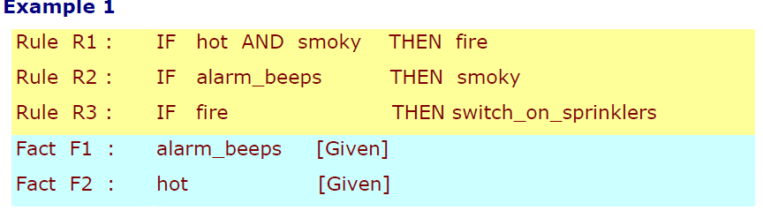
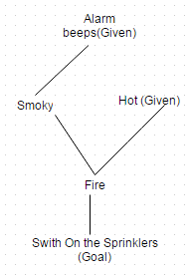
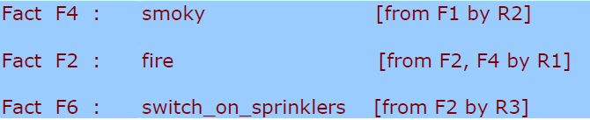
Goal is : Should sprinklers be switched on?
Solution

Slide 57
Backward Reasoning
Reverse of forward Reasoning.
The rules start with the goal .
The rules whose right side matches with the root are considered.
The process of selection is from right to left.
Once a rule is applied, its left side is then looked upon searched in the right side again. This is continued till the initial state is reached.

Slide 58
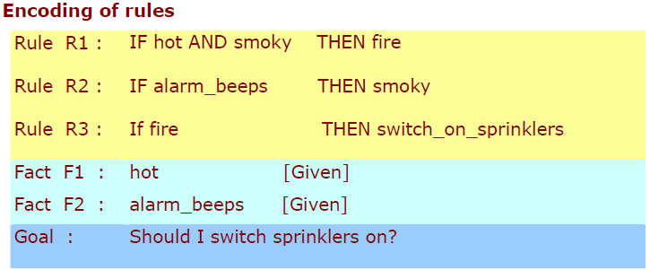
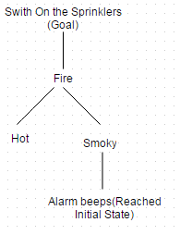
Backward Reasoning/ Chaining

Slide 59
Reasoning System for Categories
Categories are building blocks of knowledge representation schemes.
Categories can be organized and reasoned using 2 approaches:-
1. Semantic networks
Visualize knowledge-base
Efficient algorithms for category inference.
2. Description logics
Formal language for constructing and combining
category definitions.
Efficient algorithms to decide subset and superset
relationships between categories.

Slide 60
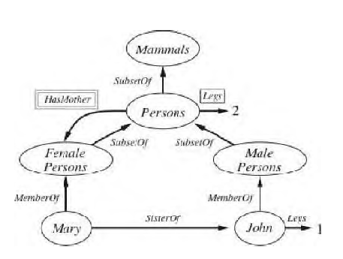
Semantic Network
Knowledge is represented as objects and relationship between objects.
It consist of nodes, links and link labels.

